Slide 1
Web Design Fundamentals /
Basic Web Design
Site Planning and Photoshop Template – ITEWEBDES / ITWD113

Slide 2
Graphic Design and Page Template Creation
Generally, web designers create a mockup for each page layout in the Web site. This is a sketch of proposed design that indicates the general layout of a Web site home page and other pages.
Notes:
Always checked for browser support

Slide 3
Wireframe
Website wireframes are simple line drawings that show the placement of elements on a web page. Using wireframes is a great way to begin a web site project, as it allows you and your client to focus on layout without the distraction of color, type and other design elements.

Slide 4
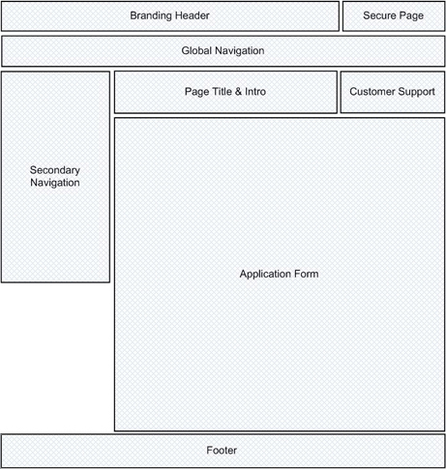
Mockups that evolve to a more refined state is called WIREFRAME.
This is a sample wireframe for page layout.

Slide 5
Web site Visual Structure
The structure of a web page is imposed by the grid or page template you choose for your page design

Slide 6
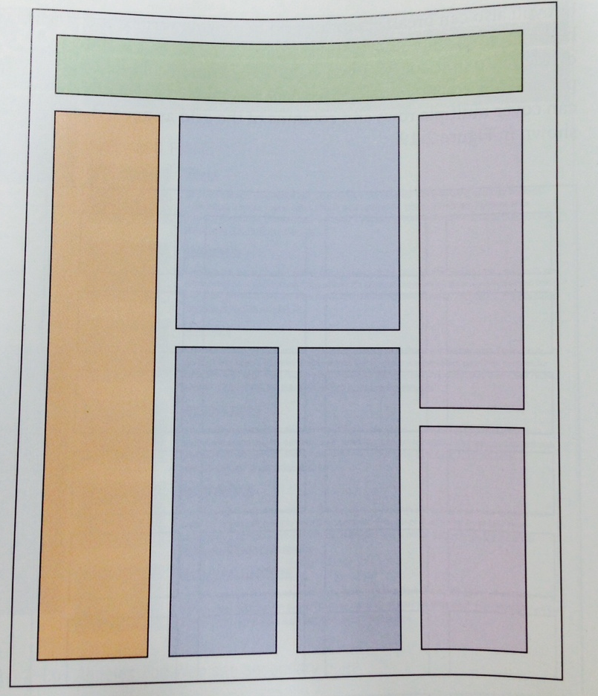
Four-column grid with layout elements
Grid sections can provide placement guidelines for page elements which can cover multiple rows and columns

Slide 7
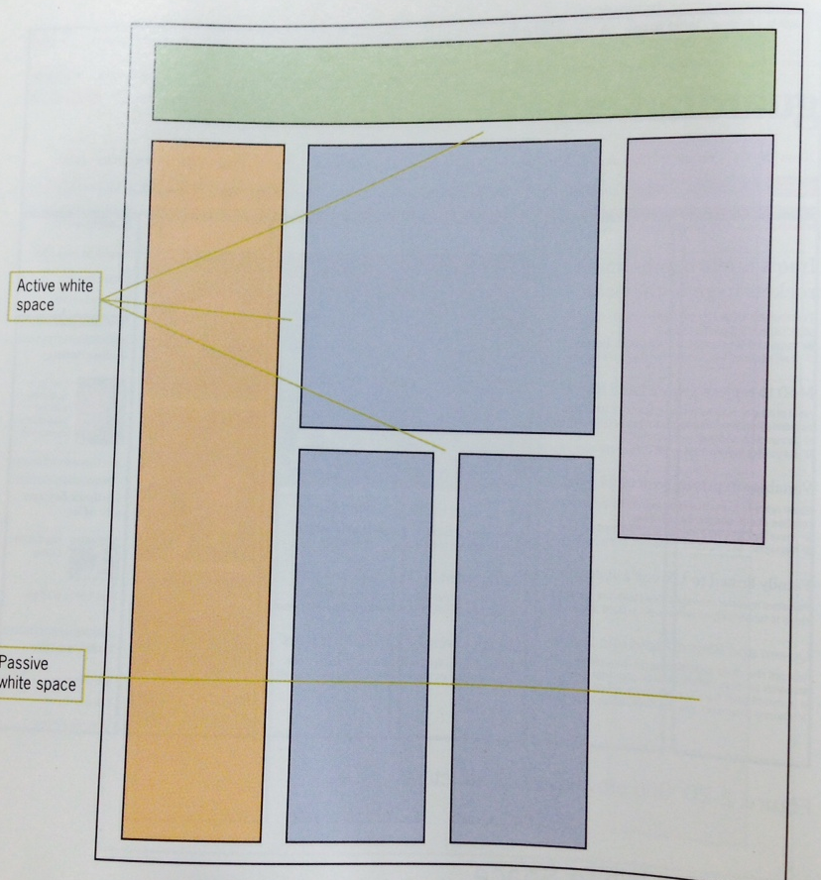
Areas of active and passive white space
Active white space – it structures and separates content
Passive – includes black areas that border the screen

Slide 8
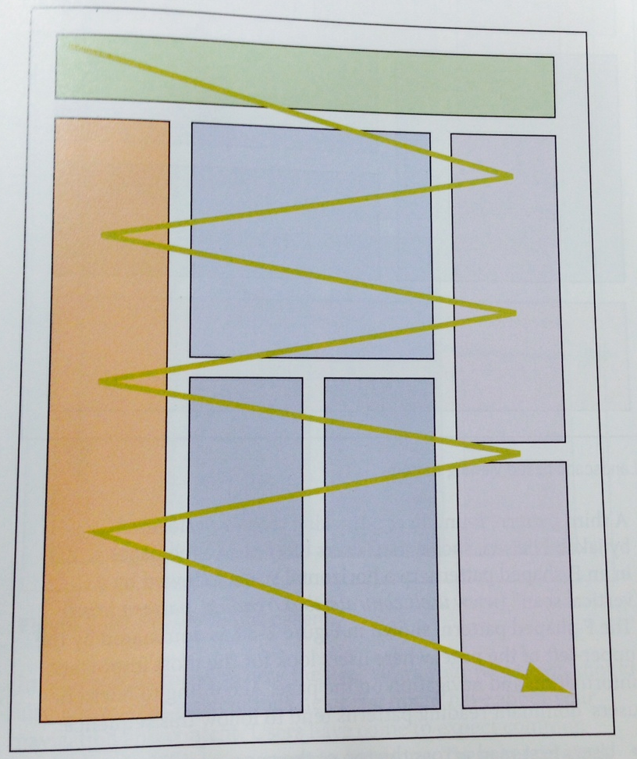
Paper-based reading pattern
According to human engineering studies scan pages with paper-based reading habits making eye moves from left to right and back again.

Slide 9
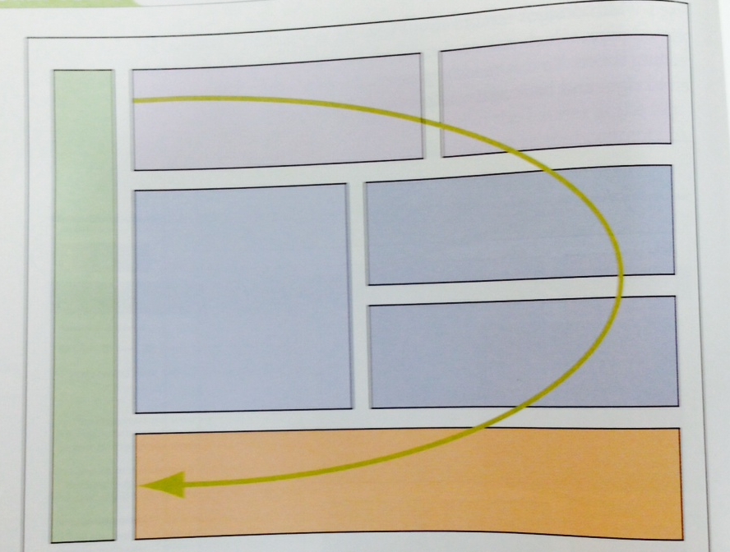
Landscape-based viewing pattern
In contrast to above pattern, users may also scan information following clockwise pattern

Slide 10
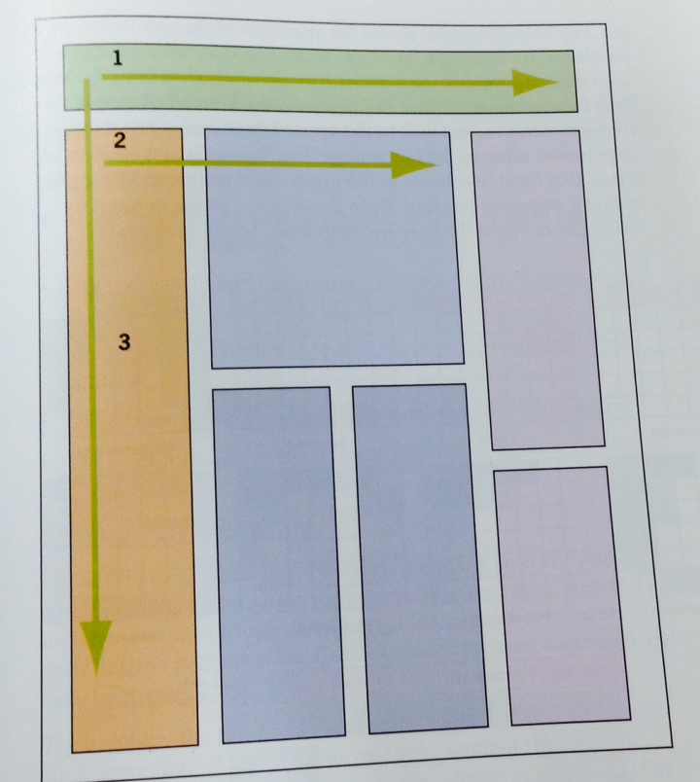
F-based viewing pattern
This is also a pattern found in eye-tracking studies, users often read web pages in an F-shaped pattern.
Users read first across the top page
Move down the page a bit
Then left side in a vertical movement

Slide 11
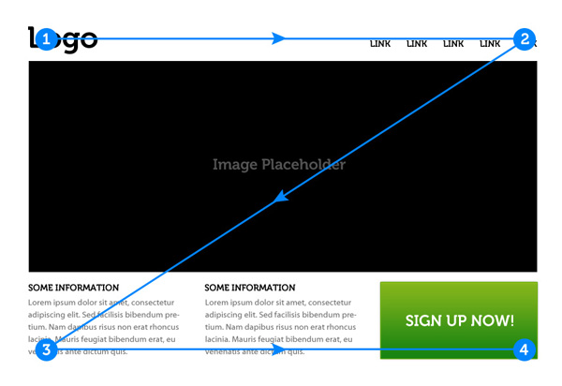
Z Flow PATTERN
The Z-Layout is a great way to start just about any web design project because it addresses the core requirements for any effective site: branding, hierarchy, structure, and call to action.

Slide 12
PARALLAX FLOW PATTERN
Parallax scrolling offers a better user experience through interaction, engagement, and depth into the story your brand is trying to tell.
Parallax is a web design technique that allows components of a web page to move at varying speeds when a user scrolls.
Notes:
To be research, this is a new design

Slide 13
What to include?
WIREFRAME
All of the important elements of a web page should be represented in your website wireframe.
Use simple shapes instead of actual graphics, and label them. These elements include:

Slide 14
Navigation:
Buttons for users to visit the main sections of your site.
Company logo:
Can just be represented by a box.
Content areas:
Where will your different sections of content appear?
Search boxes
User login areas

Slide 15
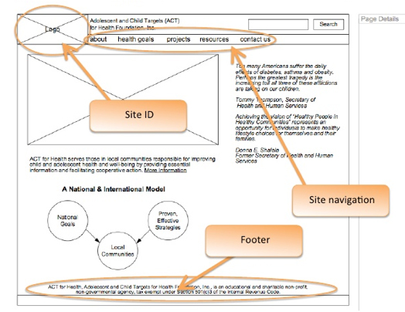
WIREFRAME
A wireframe is an outline of a website. It is the first step of the creation of a site.

Slide 16
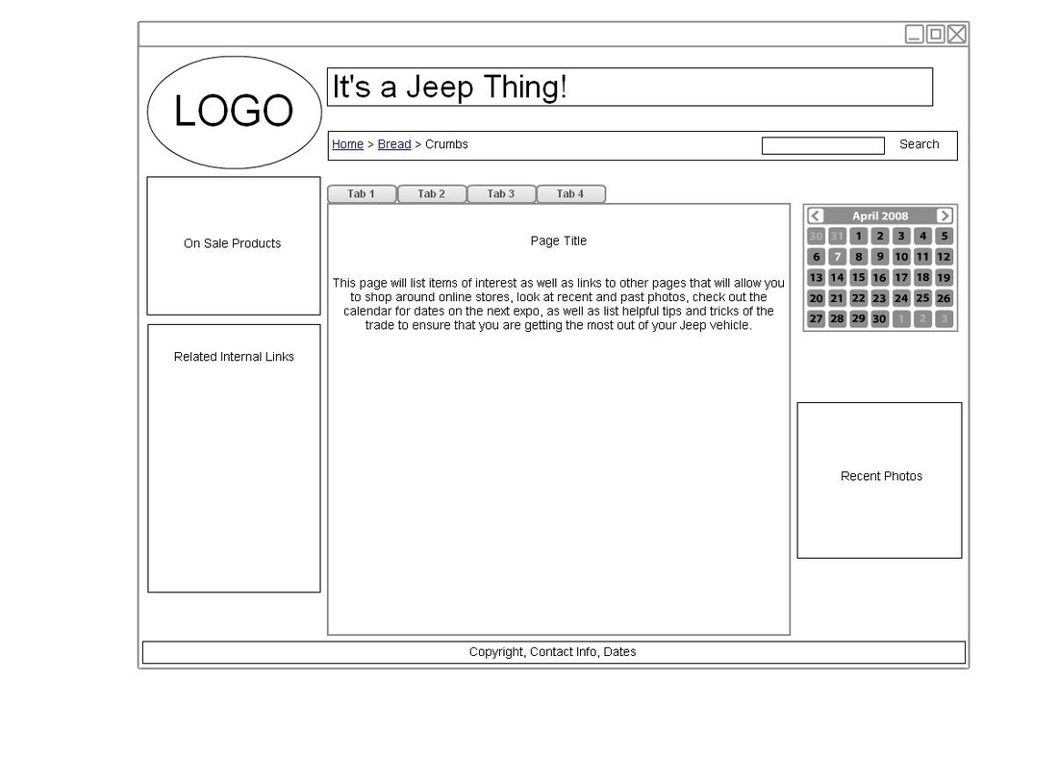
WIREFRAME
Good web designers start out with a wireframe sketch in order to visualize their ideas on paper.

Slide 17
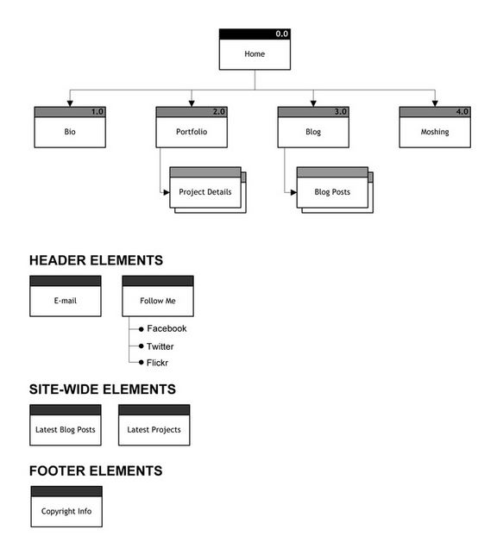
SITEMAP
A sitemap is a visual map of the navigation of a website. The more pages your site has, the more complicated your site map will be.
Notes:
To be research, this is a new design

Slide 18

PHOTOSHOP SLICE TOOL
WEBSITE MOCKUP AND WEB TEMPLATE

Slide 19
While you could use Photoshop to build real web pages, you shouldn’t; you’re much better off using a program designed for the job, like Adobe Dreamweaver.

Slide 20
That said, the Slice tool comes in really handy in a few situations:
Building a website prototype.
If you slice up your design and assign different hyperlinks to navigation bars, you can give the client a good idea of how the navigation in the final website will feel.

Slide 21
Making an image map
The Slice tool lets you add hyperlinks to certain portions of a single image.
Making an image-heavy page load a bit faster
Chopping images into pieces makes them load a little at a time instead of in one big piece. However, this is becoming less of a problem as more people get faster Internet connections.

Slide 22
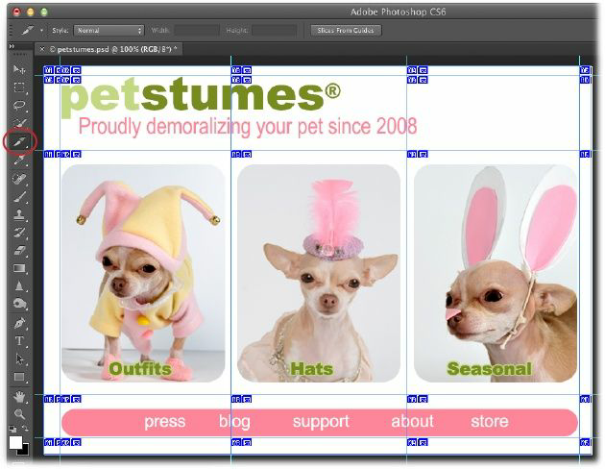

Slide 23
Creating Slices
Once you’ve created an image or design that you want to chop up, you can use the Slice tool to draw the pieces by hand or make Photoshop create slices from individual layers by choosing Layer→New Layer Based Slices.
You can also make Photoshop slice an images according to the guides you’ve drawn (discussed later in this section).

Slide 24
Steps
Turn on Photoshop’s Rulers and draw guides around the areas you want to slice.
Press C to grab the Slice tool.
Trot up to the Options bar and click the Slices From Guides button.

Slide 25
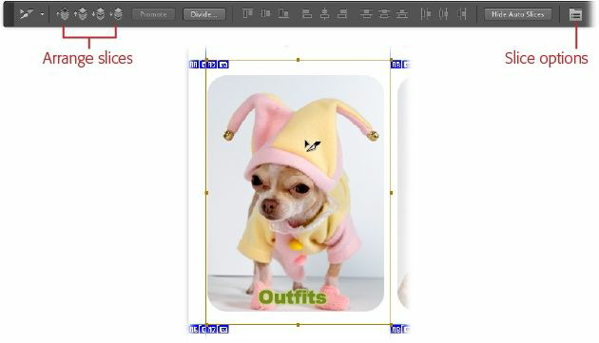
Modifying Slices

Slide 26
Resize the slice. Once you select a slice, you can drag any of its corner or center handles (they look like tiny solid squares) to make it bigger or smaller.
Move the slice. Click within the slice and then drag it to another location. To make it so you can drag the slice only horizontally or vertically, hold the Shift key as you drag.

Slide 27
Saving Slices
Once you’ve set all the options for your slices, it’s time to save them to use on the Web.
Use the File→“Save for Web” dialog box to set all those file-type, compression, and other options discussed earlier in this chapter.
(If you use File→Save As, all your slice options will fly right out the window.)

Slide 28
When you’re finished, click Save and tell Photoshop where you want to store the files. If you’ve assigned URLs to the slices, be sure to choose “HTML and Images” from the Format pop-up menu at the bottom of the Save Optimized As dialog box, as shown.

Slide 29
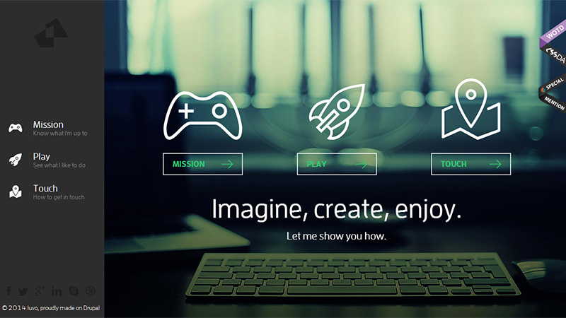
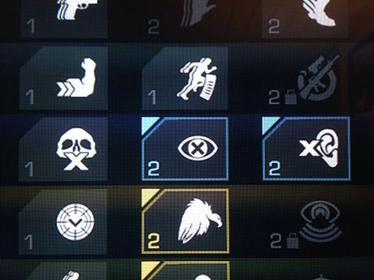

DESIGN TRENDS FOR 2015 www.thenextweb.com
1. Line Icons and Ghost Buttons – transparent button outlined with a thin line
Notes:
C

Slide 30
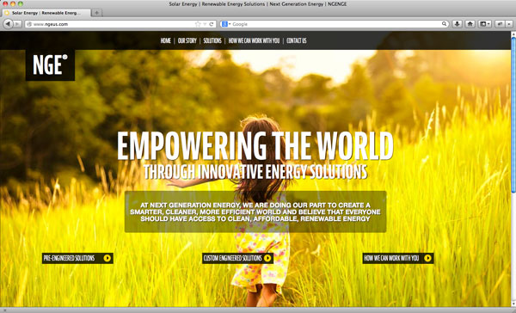


DESIGN TRENDS FOR 2015 www.thenextweb.com
2. No Header Background Image –large customized photography appeared at a maximum width and ran to the edge of the browser just like magazine
Notes:
C

Slide 31
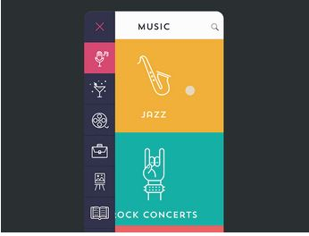
DESIGN TRENDS FOR 2015 www.thenextweb.com
3. Material Design - This Web design trend is a maturation of flat design—a popular technique in User Interface design that focuses on clean, minimal use of color, shapes and typography.
Notes:
C

Slide 32
End of Module

